Slide 1

Preliminary of Community Search and Core/Truss Decomposition
2022.9
Notes:
Font
Bree Serif = http://www.fontsquirrel.com/fonts/bree-serif?q%5Bterm%5D=bree+serif&q%5Bsearch_check%5D=Y
Montserrat = http://www.fontsquirrel.com/fonts/montserrat?q%5Bterm%5D=Montserrat&q%5Bsearch_check%5D=Y
Hand Shake Icon = http://thenounproject.com/term/hand-shake/60140/
Once you insert the picture, make sure you send the picture to the back by click on Arrange button on the menu bar > send to the back

Slide 2
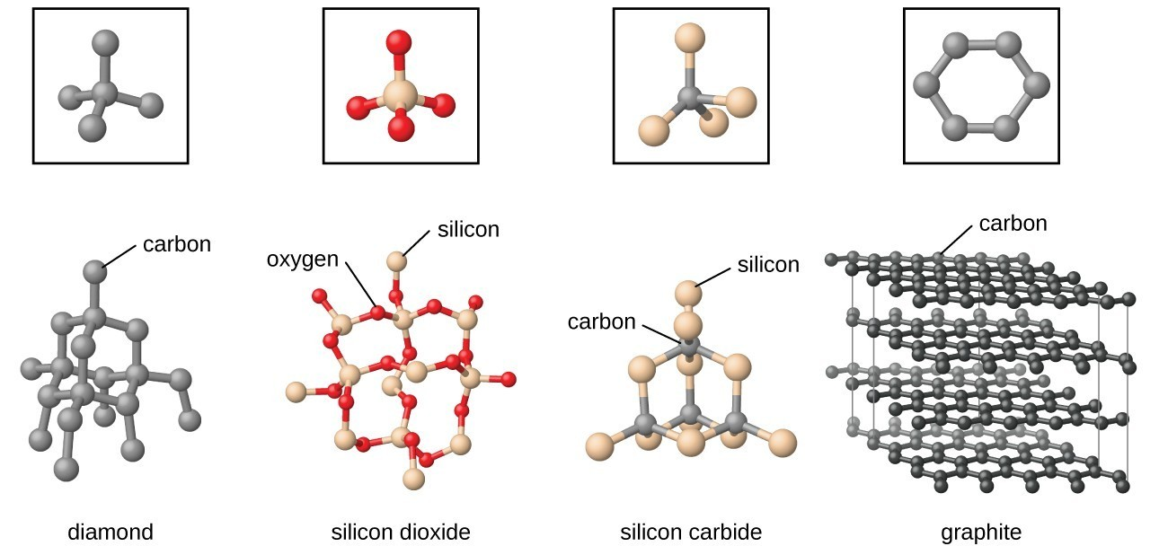
Networks
Networks are everywhere (e.g., chemistry, biology, social networks, the Web, etc.)

Slide 3
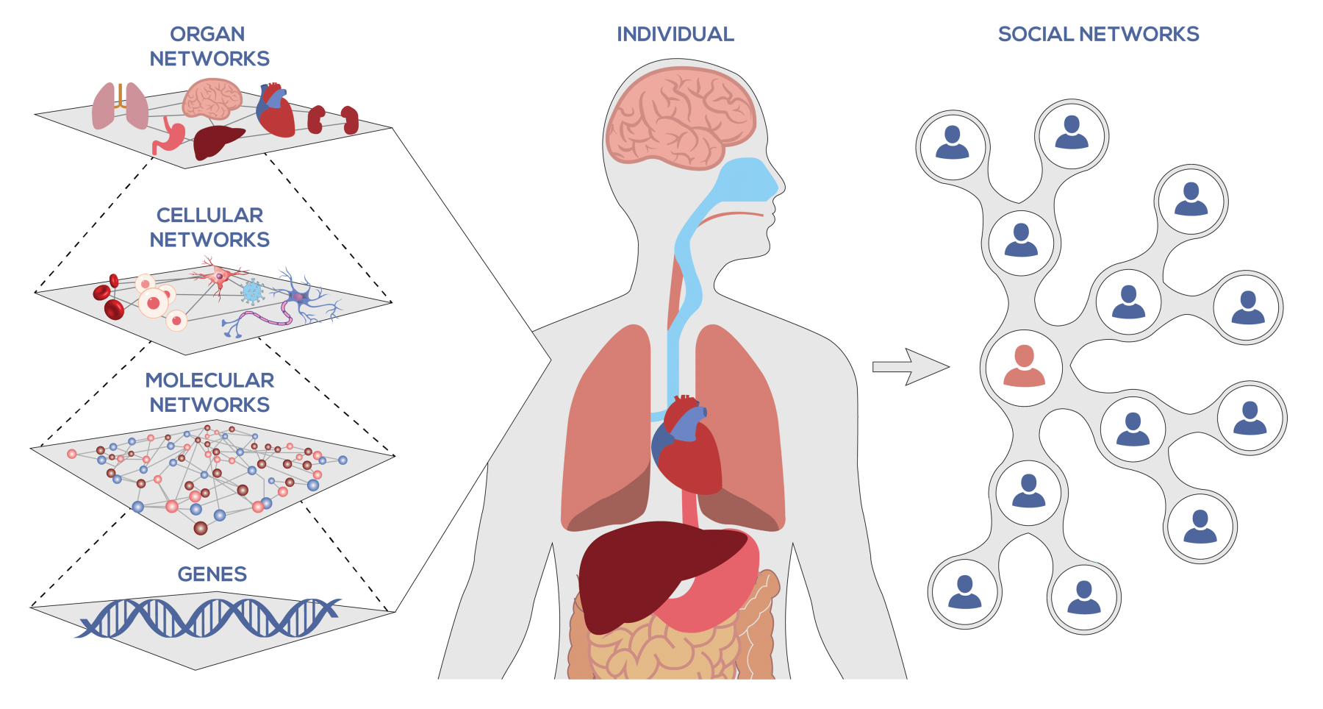

Networks
Networks are everywhere (e.g., chemistry, biology, social networks, the Web, etc.)

Slide 4
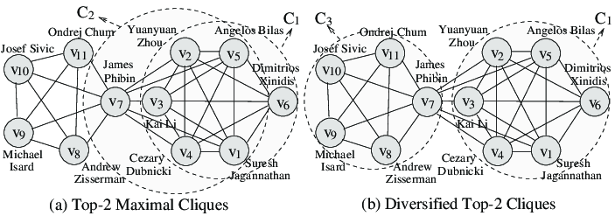
Networks
Networks are everywhere (e.g., chemistry, biology, social networks, the Web, etc.)

Slide 5
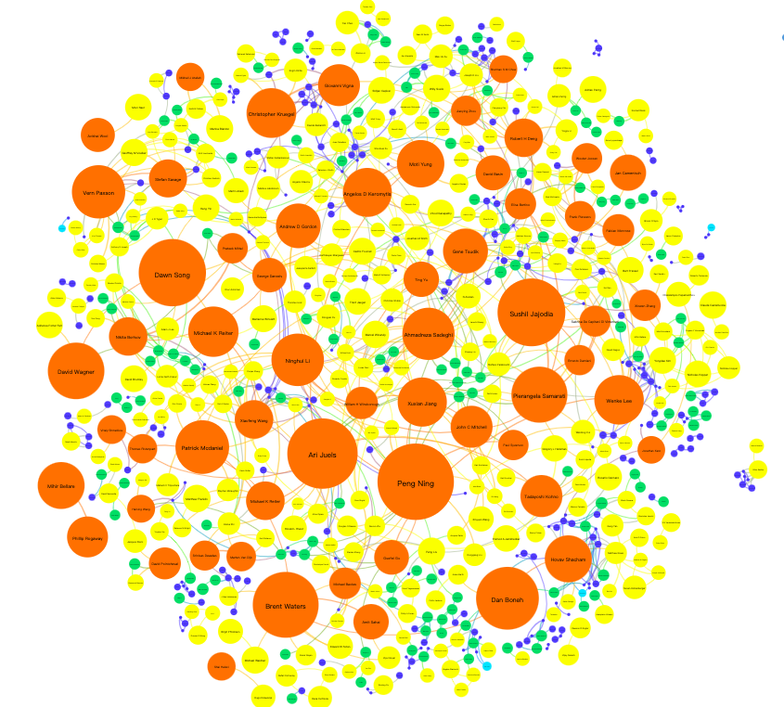
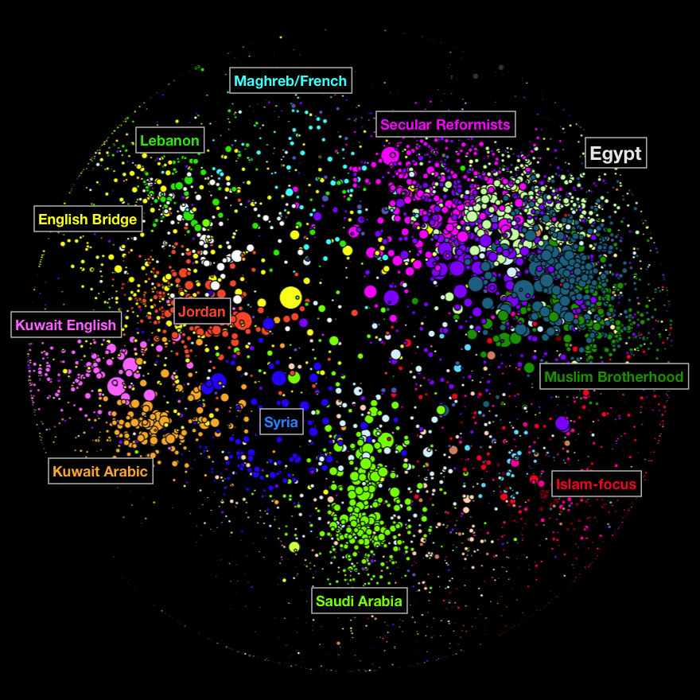
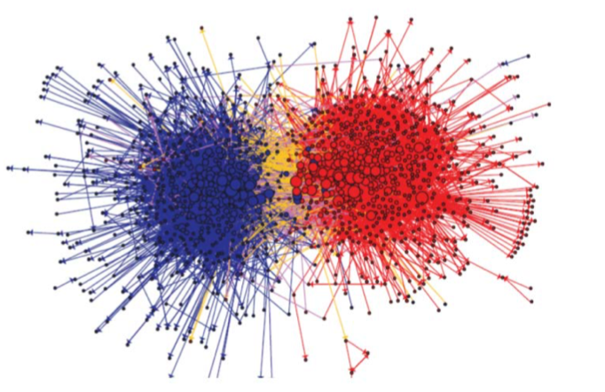
Communities
Communities naturally exist in networks

Slide 6
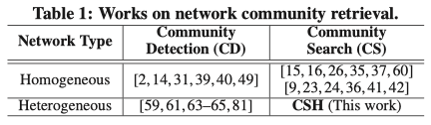
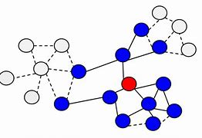
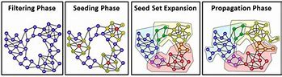
Communities
同质网络
异质网络
社区发现
社区查询
类似于图分类，将一个网络中所有可能的社区都进行识别和挖掘，输入一个图，输出多个可能的社区
类似于子图查询，挖掘关于某一个节点的紧密社区，输入一个图+一个查询节点，输出包含这个节点的紧密社区
目标节点（人）

Slide 7

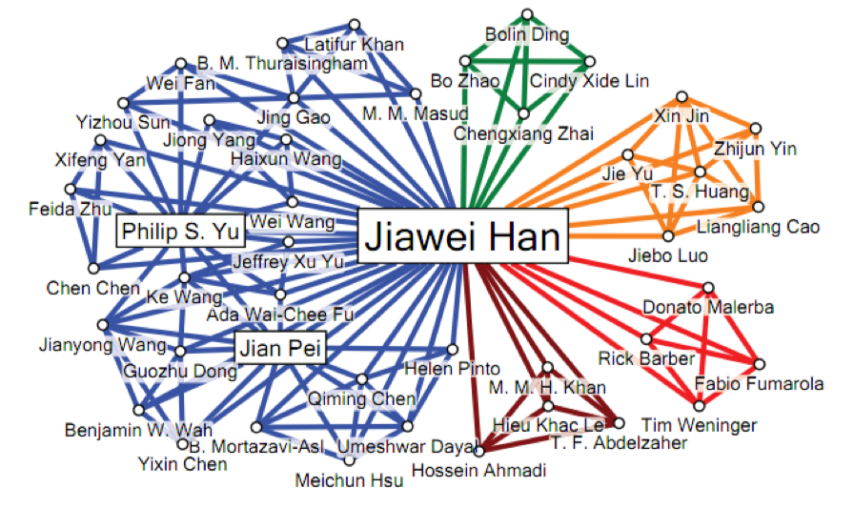
Example of community search
Input query
Prof. Jiawei Han
Return 5 communities contain Jiawei Han

Slide 8
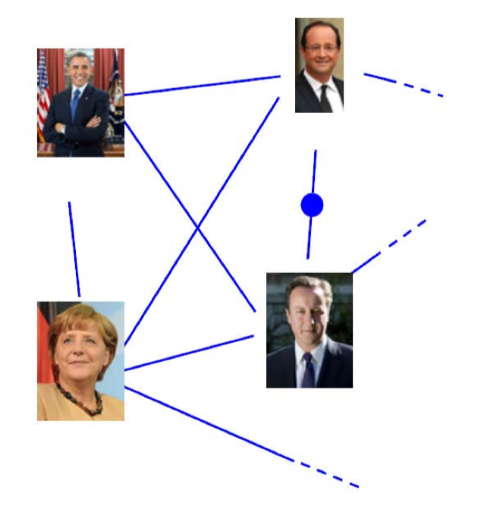
Application of community search
Participants should be “close” to the organizers
Event Planning
Everyone should know sufficiently many in the party
Graph should be connected
# participants should not be too small or too large

Slide 9
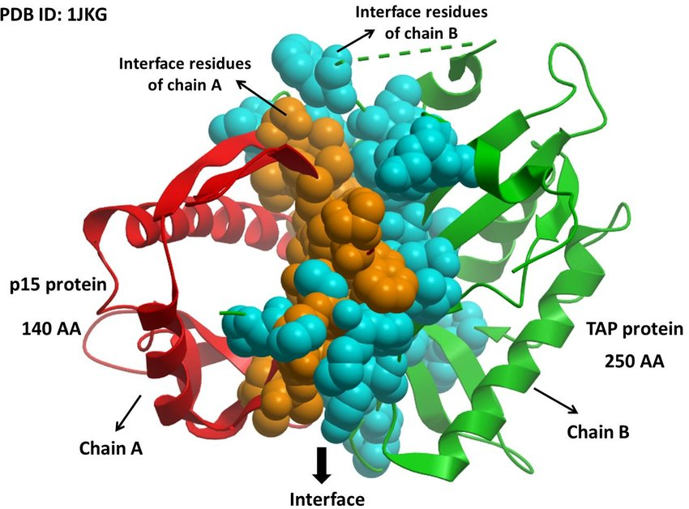

Application of community search
Participants should be “close” to the organizers
Event Planning
Everyone should know sufficiently many in the party
Graph should be connected
# participants should not be too small or too large
Biological data analysis
寻找基因社区，揭示隐藏疾病的内在联系

Slide 10
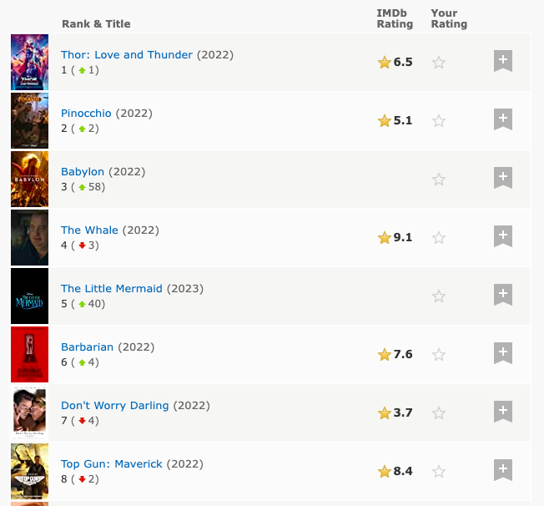
Application of community search
Participants should be “close” to the organizers
Event Planning
Everyone should know sufficiently many in the party
Graph should be connected
# participants should not be too small or too large
Biological data analysis
Social marketing
Movie Recommendation
寻找用户所属电影兴趣组，推荐同社区高分电影
寻找基因社区，揭示隐藏疾病的内在联系

Slide 11
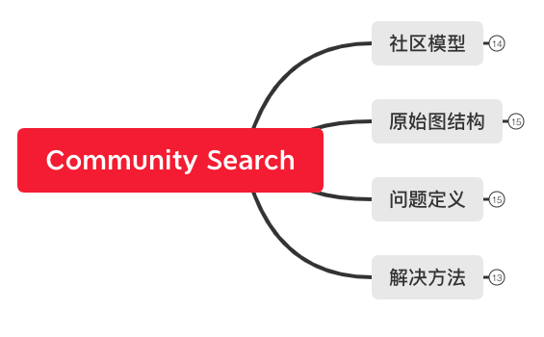
How to find the community of interest
Metrics of community’s cohesiveness
Dataset where we perform community search
Problem definition of community search
Algorithms that we design to solve above CS problem

Slide 12
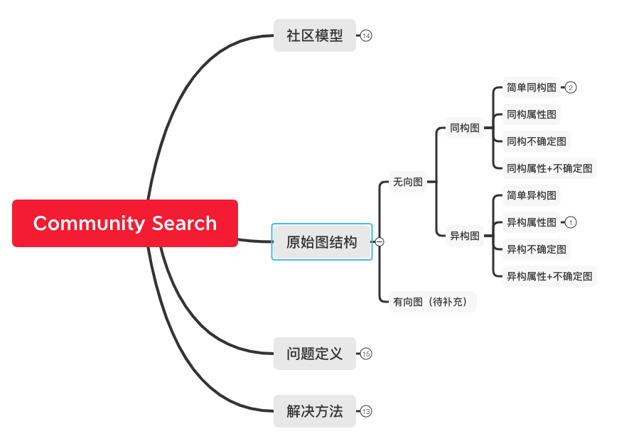
Different types of graph

Slide 13
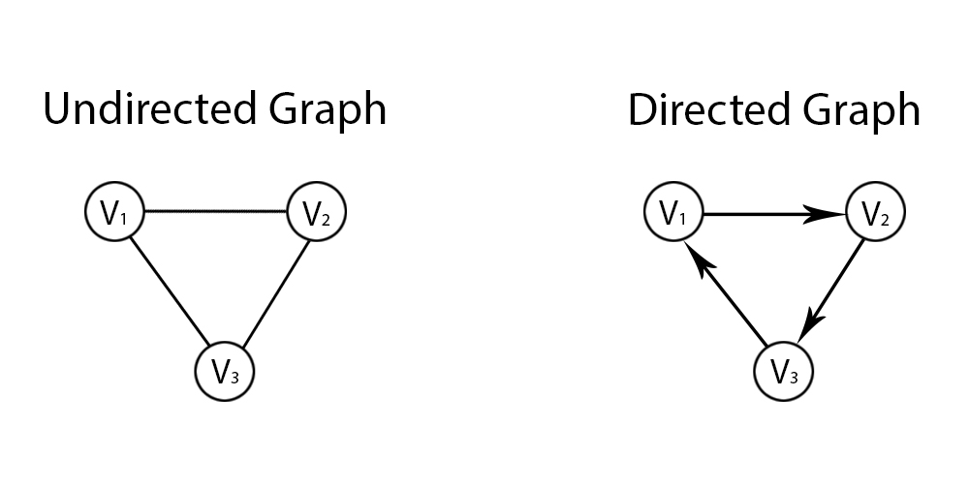





Different types of graph

Slide 14
Different types of graph

Slide 15
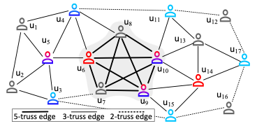
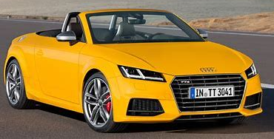
Different types of graph
Heterogeneous graph 异构图
Homogeneous graph 同构图
EA211_TSI
(Device)
Lamando
engine
(Automobile)
Porsche
designCompany
(Company)
assembly
Volkswagen
manufacturer
Porsche_911
Audi_TT
(Company)
location
(Automobile)
(Automobile)
country
designer
nationality
Germany
(Country)
designer
Peter_Schreyer
assembly
KIA_K5
(Person)
BMW_320
(Automobile)
(Automobile)

Slide 16
Different types of graph

Slide 17
Different types of graph
简单同构图

Slide 18
Different types of graph
简单同构图
attribute | value
age | 20
education | master
同构属性图

Slide 19
Different types of graph
简单同构图
0.9
1.0
1.0
0.2
0.9
0.2
0.8
1.0
0.8
attribute | value
age | 20
education | master
0.7
0.9
0.8
1.0
同构属性图
同构不确定图

Slide 20
Different types of graph
attribute | value
age | 20
education | master
0.9
1.0
1.0
0.2
0.9
0.2
0.8
1.0
0.8
0.7
0.9
同构属性+不确定图
0.8
1.0
简单同构图
0.9
1.0
1.0
0.2
0.9
0.2
0.8
1.0
0.8
attribute | value
age | 20
education | master
0.7
0.9
0.8
1.0
同构属性图
同构不确定图

Slide 21
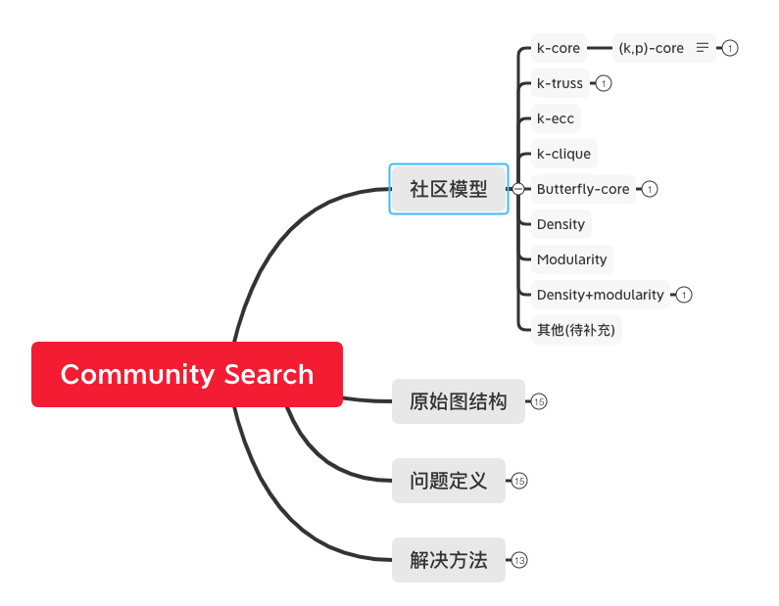
Different types of community structure
不同图结构作为社区的基础结构

Slide 22
Different types of community structure
K-core: every node has degree at least k in this subgraph
k越大，社区结构越紧密
1-core
2-core
2-core
3-core
3-core
4-core

Slide 23
Different types of community structure
Triangle: fundamental building blocks of networks
K-truss: every edge is contained in at least (k-2) triangles in the subgraph
3-truss
3-truss
4-truss
k越大，社区结构越紧密
4-truss
5-truss

Slide 24
Different types of community structure
K-core VS. K-truss
1-core
2-core
2-core
3-core
3-truss
Not a k-truss
K-truss通常是比K-core更紧密的图结构

Slide 25
Different types of community structure
K-core VS. K-truss
任意边的2个端点可能没有共同邻居
e.g., 2个人没有共同好友
任意边的2个端点必有至少1个共同邻居
e.g., 2个人至少有1位共同好友
3-core
3-truss
K-truss通常是比K-core更紧密的图结构

Slide 26
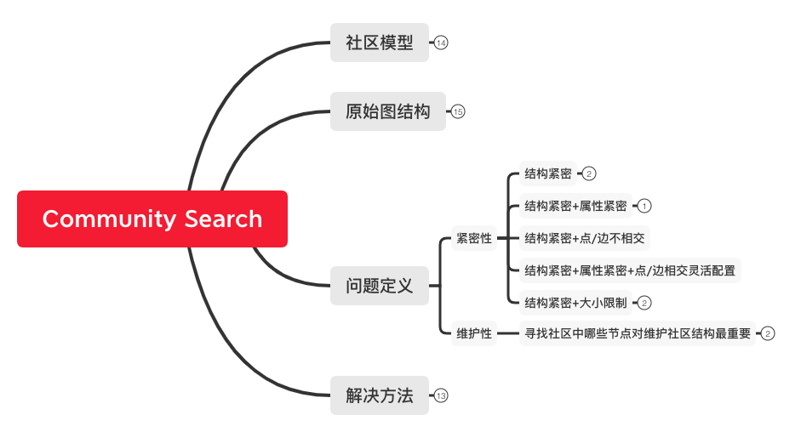
General problem definition of community search

Slide 27
General problem definition of community search
针对某种原始图
以社区模型定义的社区结构为基础
k-core / k-truss
寻找满足一系列约束条件的目标社区
结构/属性/概率/尺寸的最优化
结构最紧密
属性最相似
存在概率最大
尺寸最大/最小，或尺寸限制

Slide 28
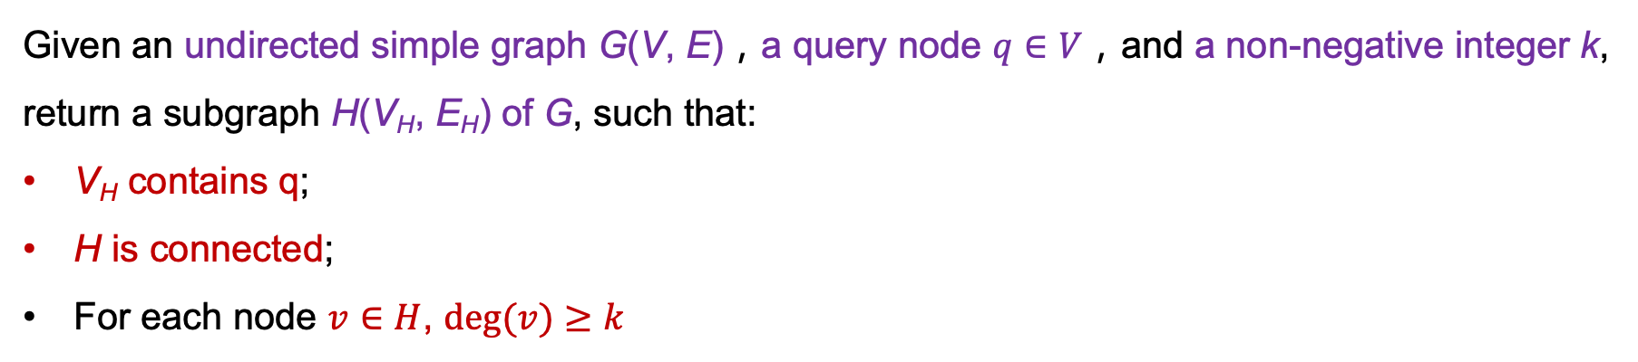
General problem definition of community search
最简单的问题定义：
Given an undirected simple graph G(V, E)，a query node $q∈V$，and a non-negative integer k, return a subgraph H(V_{H}, E_{H}) of G, such that:
V_{H} contains q;
H is connected;
For each node $v∈H$, $deg⁡(v)≥k$
query

Slide 29
General problem definition of community search
k=1
query
k=2
k=3/4 无满足条件时社区

Slide 30
General problem definition of community search
k=1
query
k=2
k=4 无满足条件时社区
k=3

Slide 31
General problem definition of community search
k=1
k=2
query
k=3/4

Slide 32
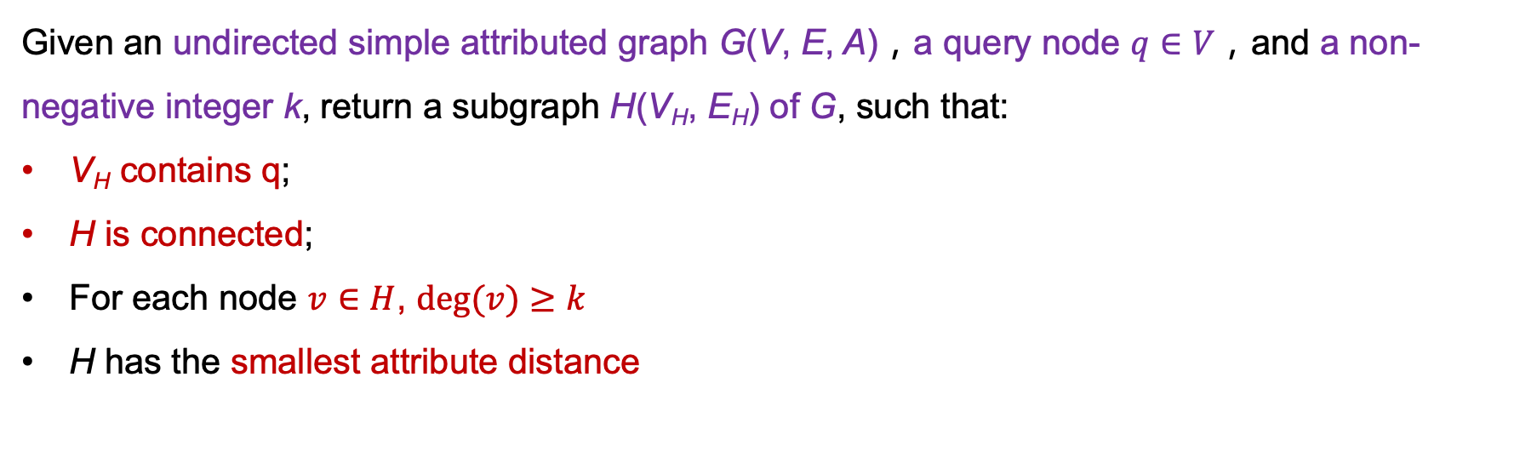
General problem definition of community search
加入属性约束的问题定义：
Given an undirected simple attributed graph G(V, E, A)，a query node $q∈V$，and a non-negative integer k, return a subgraph H(V_{H}, E_{H}) of G, such that:
V_{H} contains q;
H is connected;
For each node $v∈H$, $deg⁡(v)≥k$
H has the smallest attribute distance
<DM,CS,NLP,AI,KG,171,51>
query
<DM,SW,ML,KG,79,46>
不仅要满足k-core约束，还要满足社区内的节点属性要相似
<DM,DB,SW,ML,IR,CV,76,36>

Slide 33
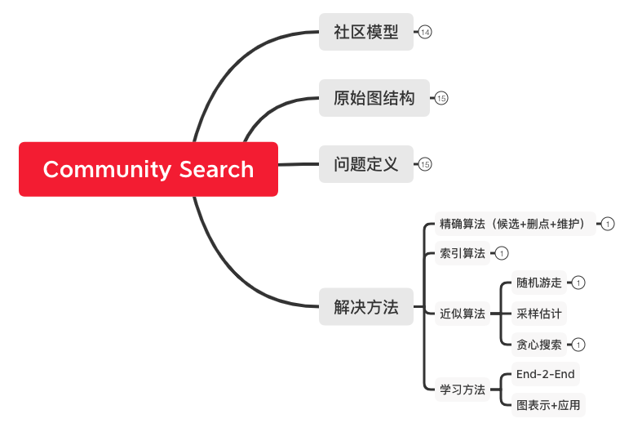
General solution
精确算法：基于枚举方法，提供baseline，速度慢
索引算法：基于coreness/trussness的索引，加速
近似算法：获得近似结果，以精度换时间
学习方法：离线学习+在线应用，在线快、精度无保证

Slide 34
General solution
K-core decomposition
K-truss decomposition
是实现精确算法/索引算法的基础

Slide 35
General solution
K-core decomposition: find all nodes’ coreness
coreness: 一个节点所属最大k-core的k值
11
9
10
13
12
8
1
4
7
14
2
5
6
17
16
3
15
18

Slide 36
General solution
11
1-core
9
10
13
12
8
K-core decomposition: find all nodes’ coreness
4
7
coreness: 一个节点所属最大k-core的k值
14
5
6
17
16
3
15
18
11
11
3-core
4-core
10
13
10
13
9
12
12
8
8
8
4
7
4
7
4
7
2-core
6
5
6
5
6
5

Slide 37
11
General solution
9
10
13
12
8
K-core decomposition: find all nodes’ coreness
1
4
7
coreness: 一个节点所属最大k-core的k值
14
2
5
6
17
16
3
15
18
 | 1 | 2 | 3 | 4 | 5 | 6 | 7 | 8 | 9 | 10 | 11 | 12 | 13 | 14 | 15 | 16 | 17 | 18
k=0 | ✓ | ✓
k=1 |  |  | ✓ |  |  |  |  |  |  |  |  |  |  | ✓ | ✓ | ✓ | ✓ | ✓
k=2 |  |  |  |  |  |  |  |  | ✓
k=3 |  |  |  |  |  |  |  |  |  | ✓ | ✓ | ✓ | ✓
k=4 |  |  |  | ✓ | ✓ | ✓ | ✓ | ✓

Slide 38
11
General solution
9
10
13
12
8
K-core community search:
find a connected community that contains query
1
4
7
14
2
5
6
17
8
16
Query ID=6
Input k=4
4
7
3
15
18
5
6
 | 1 | 2 | 3 | 4 | 5 | 6 | 7 | 8 | 9 | 10 | 11 | 12 | 13 | 14 | 15 | 16 | 17 | 18
k=0 | ✓ | ✓
k=1 |  |  | ✓ |  |  |  |  |  |  |  |  |  |  | ✓ | ✓ | ✓ | ✓ | ✓
k=2 |  |  |  |  |  |  |  |  | ✓
k=3 |  |  |  |  |  |  |  |  |  | ✓ | ✓ | ✓ | ✓
k=4 |  |  |  | ✓ | ✓ | ✓ | ✓ | ✓

Slide 39
11
General solution
9
10
13
12
8
K-core community search:
find a connected community that contains query
1
4
7
14
2
5
6
17
8
16
Query ID=6
Input k=3
4
7
3
15
18
5
6
 | 1 | 2 | 3 | 4 | 5 | 6 | 7 | 8 | 9 | 10 | 11 | 12 | 13 | 14 | 15 | 16 | 17 | 18
k=0 | ✓ | ✓
k=1 |  |  | ✓ |  |  |  |  |  |  |  |  |  |  | ✓ | ✓ | ✓ | ✓ | ✓
k=2 |  |  |  |  |  |  |  |  | ✓
k=3 |  |  |  |  |  |  |  |  |  | ✓ | ✓ | ✓ | ✓
k=4 |  |  |  | ✓ | ✓ | ✓ | ✓ | ✓

Slide 40
11
General solution
9
10
13
12
8
K-core community search:
find a connected community that contains query
1
4
7
14
11
2
5
6
17
9
10
13
Query ID=6
Input k=2
12
16
8
3
4
7
15
18
5
6
 | 1 | 2 | 3 | 4 | 5 | 6 | 7 | 8 | 9 | 10 | 11 | 12 | 13 | 14 | 15 | 16 | 17 | 18
k=0 | ✓ | ✓
k=1 |  |  | ✓ |  |  |  |  |  |  |  |  |  |  | ✓ | ✓ | ✓ | ✓ | ✓
k=2 |  |  |  |  |  |  |  |  | ✓
k=3 |  |  |  |  |  |  |  |  |  | ✓ | ✓ | ✓ | ✓
k=4 |  |  |  | ✓ | ✓ | ✓ | ✓ | ✓

Slide 41
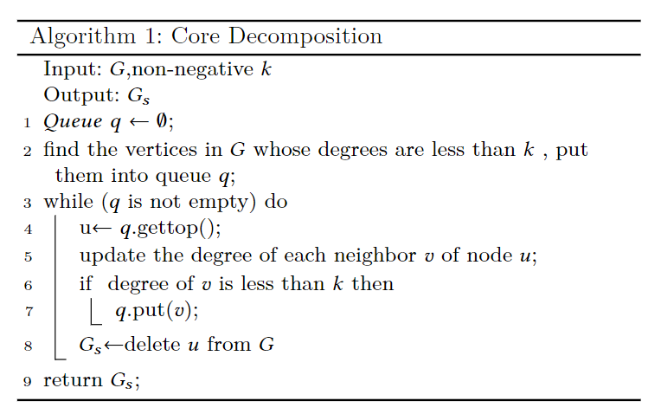
General solution
K-core decomposition
11
对节点按度数升序排列
对小于k的节点放入队列
依次弹出队列中节点待删除
更新其他节点度数
将新满足度数小于k的节点放入队列
删除待删节点及其邻边
直至没有待删点为止

Slide 42
ID | degree
1 | 0
2 | 0
3 | 1
14 | 1
15 | 1
17 | 1
18 | 1
9 | 2
11 | 3
12 | 3
13 | 3
4 | 4
7 | 4
10 | 4
5 | 5
6 | 5
8 | 5
16 | 5
General solution
K-core decomposition
11
9
10
13
12
8
1
4
7
14
2
5
6
17
16
3
15
18
If input k = 1

Slide 43
ID | degree
3 | 1
14 | 1
15 | 1
17 | 1
18 | 1
9 | 2
11 | 3
12 | 3
13 | 3
4 | 4
7 | 4
10 | 4
5 | 5
6 | 5
8 | 5
16 | 5
General solution
K-core decomposition
11
9
10
13
12
8
4
7
14
5
6
17
16
3
15
18
If input k = 1

Slide 44
General solution
K-core decomposition
11
 | 1 | 2 | 3 | 4 | 5 | 6 | 7 | 8 | 9 | 10 | 11 | 12 | 13 | 14 | 15 | 16 | 17 | 18
k=0 | ✓ | ✓
k=1
k=2
k=3
k=4
9
10
13
12
8
4
7
14
5
6
17
16
3
15
18
If input k = 1

Slide 45
ID | degree
3 | 1
14 | 1
15 | 1
17 | 1
18 | 1
9 | 2
11 | 3
12 | 3
13 | 3
4 | 4
7 | 4
10 | 4
5 | 5
6 | 5
8 | 5
16 | 5
General solution
K-core decomposition
11
9
10
13
12
8
4
7
14
5
6
17
16
3
15
18
If input k = 2

Slide 46
ID | degree
3 | 1
14 | 1
15 | 1
17 | 1
18 | 1
9 | 2
11 | 3
12 | 3
13 | 3
4 | 4
7 | 4
10 | 4
5 | 4
6 | 5
8 | 5
16 | 5
General solution
K-core decomposition
11
9
10
13
12
8
4
7
14
5
6
17
16
3
15
18
If input k = 2

Slide 47
ID | degree
14 | 1
15 | 1
17 | 1
18 | 1
9 | 2
11 | 3
12 | 3
13 | 3
4 | 4
7 | 4
10 | 4
5 | 4
6 | 5
8 | 5
16 | 4
General solution
K-core decomposition
11
9
10
13
12
8
4
7
14
5
6
17
16
15
18
If input k = 2

Slide 48
ID | degree
15 | 1
17 | 1
18 | 1
9 | 2
11 | 3
12 | 3
13 | 3
4 | 4
7 | 4
10 | 4
5 | 4
6 | 5
8 | 5
16 | 3
General solution
K-core decomposition
11
9
10
13
12
8
4
7
5
6
17
16
15
18
If input k = 2

Slide 49
ID | degree
17 | 1
18 | 1
9 | 2
11 | 3
12 | 3
13 | 3
4 | 4
7 | 4
10 | 4
5 | 4
6 | 5
8 | 5
16 | 2
General solution
K-core decomposition
11
9
10
13
12
8
4
7
5
6
17
16
18
If input k = 2

Slide 50
ID | degree
18 | 1
9 | 2
11 | 3
12 | 3
13 | 3
4 | 4
7 | 4
10 | 4
5 | 4
6 | 5
8 | 5
16 | 1
General solution
K-core decomposition
11
9
10
13
12
8
4
7
5
6
16
18
If input k = 2

Slide 51
ID | degree
18 | 1
16 | 1
9 | 2
11 | 3
12 | 3
13 | 3
4 | 4
7 | 4
10 | 4
5 | 4
6 | 5
8 | 5
General solution
K-core decomposition
11
9
10
13
12
8
4
7
5
6
16
18
If input k = 2

Slide 52
ID | degree
16 | 1
9 | 2
11 | 3
12 | 3
13 | 3
4 | 4
7 | 4
10 | 4
5 | 4
6 | 4
8 | 5
General solution
K-core decomposition
11
9
10
13
12
8
4
7
5
6
16
If input k = 2

Slide 53
ID | degree
9 | 2
11 | 3
12 | 3
13 | 3
4 | 4
7 | 4
10 | 4
5 | 4
6 | 4
8 | 5
General solution
K-core decomposition
11
9
10
13
12
8
4
7
5
6
If input k = 2

Slide 54
ID | degree
9 | 2
11 | 3
12 | 3
13 | 3
4 | 4
7 | 4
10 | 4
5 | 4
6 | 4
8 | 5
General solution
K-core decomposition
11
9
10
13
12
8
4
7
 | 1 | 2 | 3 | 4 | 5 | 6 | 7 | 8 | 9 | 10 | 11 | 12 | 13 | 14 | 15 | 16 | 17 | 18
k=0 | ✓ | ✓
k=1 |  |  | ✓ |  |  |  |  |  |  |  |  |  |  | ✓ | ✓ | ✓ | ✓ | ✓
k=2
k=3
k=4
5
6
If input k = 2

Slide 55
ID | degree
9 | 2
11 | 3
12 | 3
13 | 3
4 | 4
7 | 4
10 | 4
5 | 4
6 | 4
8 | 5
General solution
K-core decomposition
11
9
10
13
12
8
4
7
5
6
If input k = 3

Slide 56
ID | degree
9 | 2
11 | 3
12 | 3
13 | 3
4 | 4
7 | 4
10 | 3
5 | 4
6 | 4
8 | 4
General solution
K-core decomposition
11
9
10
13
12
8
4
7
5
6
If input k = 3

Slide 57
ID | degree
11 | 3
12 | 3
13 | 3
4 | 4
7 | 4
10 | 3
5 | 4
6 | 4
8 | 4
General solution
K-core decomposition
11
10
13
12
8
4
7
5
6
If input k = 3

Slide 58
ID | degree
11 | 3
12 | 3
13 | 3
4 | 4
7 | 4
10 | 3
5 | 4
6 | 4
8 | 4
General solution
K-core decomposition
11
10
13
12
8
4
7
 | 1 | 2 | 3 | 4 | 5 | 6 | 7 | 8 | 9 | 10 | 11 | 12 | 13 | 14 | 15 | 16 | 17 | 18
k=0 | ✓ | ✓
k=1 |  |  | ✓ |  |  |  |  |  |  |  |  |  |  | ✓ | ✓ | ✓ | ✓ | ✓
k=2 |  |  |  |  |  |  |  |  | ✓
k=3
k=4
5
6
If input k = 3

Slide 59
ID | degree
11 | 3
12 | 3
13 | 3
4 | 4
7 | 4
10 | 3
5 | 4
6 | 4
8 | 4
General solution
K-core decomposition
11
10
13
12
8
4
7
5
6
If input k = 4

Slide 60
ID | degree
11 | 3
12 | 2
13 | 2
4 | 4
7 | 4
10 | 2
5 | 4
6 | 4
8 | 4
General solution
K-core decomposition
11
10
13
12
8
4
7
5
6
If input k = 4

Slide 61
ID | degree
12 | 2
13 | 1
4 | 4
7 | 4
10 | 1
5 | 4
6 | 4
8 | 4
General solution
K-core decomposition
10
13
12
8
4
7
5
6
If input k = 4

Slide 62
ID | degree
13 | 1
4 | 4
7 | 4
10 | 0
5 | 4
6 | 4
8 | 4
General solution
K-core decomposition
10
13
8
4
7
5
6
If input k = 4

Slide 63
ID | degree
4 | 4
7 | 4
10 | 0
5 | 4
6 | 4
8 | 4
General solution
K-core decomposition
10
8
4
7
5
6
If input k = 4

Slide 64
ID | degree
4 | 4
7 | 4
5 | 4
6 | 4
8 | 4
General solution
K-core decomposition
8
4
7
5
6
If input k = 4

Slide 65
ID | degree
4 | 4
7 | 4
5 | 4
6 | 4
8 | 4
General solution
K-core decomposition
8
4
7
 | 1 | 2 | 3 | 4 | 5 | 6 | 7 | 8 | 9 | 10 | 11 | 12 | 13 | 14 | 15 | 16 | 17 | 18
k=0 | ✓ | ✓
k=1 |  |  | ✓ |  |  |  |  |  |  |  |  |  |  | ✓ | ✓ | ✓ | ✓ | ✓
k=2 |  |  |  |  |  |  |  |  | ✓
k=3 |  |  |  |  |  |  |  |  |  | ✓ | ✓ | ✓ | ✓
k=4
5
6
If input k = 4

Slide 66
ID | degree
4 | 4
7 | 4
5 | 4
6 | 4
8 | 4
General solution
K-core decomposition
8
4
7
5
6
If input k = 5

Slide 67
ID | degree
4 | 4
7 | 4
5 | 4
6 | 4
8 | 4
General solution
K-core decomposition
8
4
7
 | 1 | 2 | 3 | 4 | 5 | 6 | 7 | 8 | 9 | 10 | 11 | 12 | 13 | 14 | 15 | 16 | 17 | 18
k=0 | ✓ | ✓
k=1 |  |  | ✓ |  |  |  |  |  |  |  |  |  |  | ✓ | ✓ | ✓ | ✓ | ✓
k=2 |  |  |  |  |  |  |  |  | ✓
k=3 |  |  |  |  |  |  |  |  |  | ✓ | ✓ | ✓ | ✓
k=4 |  |  |  | ✓ | ✓ | ✓ | ✓ | ✓
5
6
If input k = 5

Slide 68
General solution
K-truss decomposition: find all nodes’ trussness
trussness: 一个节点所属最大k-truss的k值
2
8
12
14
3
7
1
9
11
13
15
5
4
6
10

Slide 69
General solution
2
8
12
14
K-truss decomposition: find all nodes’ trussness
3
7
trussness: 一个节点所属最大k-truss的k值
1
9
5
13
15
2
8
12
14
4-truss
4
6
3
7
2
8
12
14
1
9
11
13
15
3
7
5
1
9
11
4
6
10
5
13
15
3-truss
4
6

Slide 70
General solution
K-truss decomposition: find all nodes’ trussness
trussness: 一个节点所属最大k-truss的k值
 | 1 | 2 | 3 | 4 | 5 | 6 | 7 | 8 | 9 | 10 | 11 | 12 | 13 | 14 | 15
无 |  |  |  |  |  |  |  |  |  | ✓
k=3 |  |  |  |  |  |  |  |  |  |  | ✓
k=4 | ✓ | ✓ | ✓ | ✓ | ✓ | ✓ | ✓ | ✓ | ✓ |  |  | ✓ | ✓ | ✓ | ✓

Slide 71
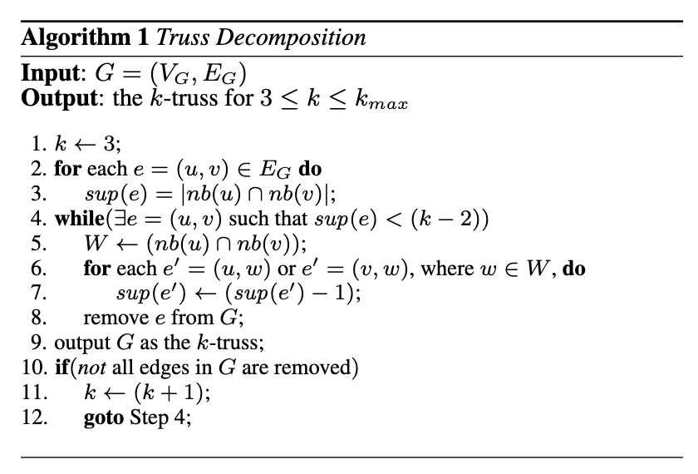
General solution
K-truss decomposition: find all nodes’ trussness
trussness: 一个节点所属最大k-truss的k值
从k=3开始计算
计算每条边的支持度support
每条支持度小于k-2的边都是待删除边
对每条待删除边获取其共同邻居
更新与共同邻居连边的支持度
删除待删边
循环3-6直至没有待删边为止
若图中还有边，则k++，继续执行3

Slide 72
General solution
K-truss decomposition: find all nodes’ trussness
trussness: 一个节点所属最大k-truss的k值
support: 一条边所属三角形的个数
2
8
12
14
support=3
3
7
support=2
1
9
11
13
15
support=1
5
support=0
4
6
10

Slide 73
General solution
K-truss decomposition: find all nodes’ trussness
trussness: 一个节点所属最大k-truss的k值
k = 3：先删除support小于1的边
2
8
12
14
support=3
3
7
support=2
1
9
11
13
15
support=1
5
support=0
4
6
10

Slide 74
General solution
K-truss decomposition: find all nodes’ trussness
trussness: 一个节点所属最大k-truss的k值
k = 3：先删除support小于1的边
2
8
12
14
support=3
3
7
support=2
1
9
11
13
15
support=1
5
support=0
4
6

Slide 75
General solution
K-truss decomposition: find all nodes’ trussness
trussness: 一个节点所属最大k-truss的k值
k = 3：先删除support小于1的边
2
8
12
14
support=3
3
7
support=2
1
9
11
13
15
support=1
 | 1 | 2 | 3 | 4 | 5 | 6 | 7 | 8 | 9 | 10 | 11 | 12 | 13 | 14 | 15
无 |  |  |  |  |  |  |  |  |  | ✓
k=3
k=4
5
support=0
4
6

Slide 76
General solution
K-truss decomposition: find all nodes’ trussness
trussness: 一个节点所属最大k-truss的k值
k = 4：再删除support小于2的边
2
8
12
14
support=3
3
7
support=2
1
9
11
13
15
support=1
5
support=0
4
6

Slide 77
General solution
K-truss decomposition: find all nodes’ trussness
trussness: 一个节点所属最大k-truss的k值
k = 4：再删除support小于2的边
2
8
12
14
support=3
3
7
support=2
1
9
13
15
support=1
5
support=0
4
6

Slide 78
General solution
K-truss decomposition: find all nodes’ trussness
trussness: 一个节点所属最大k-truss的k值
k = 4：再删除support小于2的边
2
8
12
14
support=3
3
7
support=2
1
9
13
15
support=1
 | 1 | 2 | 3 | 4 | 5 | 6 | 7 | 8 | 9 | 10 | 11 | 12 | 13 | 14 | 15
无 |  |  |  |  |  |  |  |  |  | ✓
k=3 |  |  |  |  |  |  |  |  |  |  | ✓
k=4
5
support=0
4
6

Slide 79
General solution
K-truss decomposition: find all nodes’ trussness
trussness: 一个节点所属最大k-truss的k值
k = 5：再删除support小于3的边
2
8
12
14
support=3
3
7
support=2
1
9
13
15
support=1
5
support=0
4
6

Slide 80
General solution
K-truss decomposition: find all nodes’ trussness
trussness: 一个节点所属最大k-truss的k值
k = 5：再删除support小于3的边
2
8
12
14
support=3
3
7
support=2
1
9
13
15
support=1
5
 | 1 | 2 | 3 | 4 | 5 | 6 | 7 | 8 | 9 | 10 | 11 | 12 | 13 | 14 | 15
无 |  |  |  |  |  |  |  |  |  | ✓
k=3 |  |  |  |  |  |  |  |  |  |  | ✓
k=4 | ✓ | ✓ | ✓ | ✓ | ✓ | ✓ | ✓ | ✓ | ✓ |  |  | ✓ | ✓ | ✓ | ✓
support=0
4
6

Slide 81
练习
1. 实现k-core decomposition算法
2. 实现k-truss decomposition算法
3. 数据集+验证程序 会发给大家
4. Java/Python均可
5. 2022.9.28日检查，有问题请联系：顾成杰(1746271273)、赵宇洋(1009945932)

